Slide 1
Build for Covid
Active Covid Tracker

Slide 2
Contents
Problem Statement
Proposal Summary
Symptoms Of Covid -19
Objectives
Origin Of The Proposal
Proposed Methodology
Societal And Market Impact
Intellectual Property
Future Plans For Commercialization
Flowchart

Slide 3
Problem Statement
To help the doctors in tracking the post covid patients after quarantine period, by tracking their temperature, heart rate and oxygen level in blood of the patient and tracking their GPS location through IOT Technologies.
To provide an affordable device to the unaffected population in order to help them to keep a track of their health.
To provide the free rental services of our product in public places for the people who cannot afford it.
To provide an alert to the user when he/she comes in close contact (8meters) with our peer customer who is experiencing covid symptoms.

Slide 4
PROPOSAL SUMMARY
An IoT based wrist band is proposed to track the patients whether there is a possibility of getting affected or reappearing corona to the cured patients or for the people who were released from several days of quarantined by monitoring their body temperature, the oxygen level in blood & pulse rate through the internet itself.
Corona or COVID-19 is a pandemic disease according to World Health Organization. The common symptoms of Covid-19 include Lack of oxygen supply in blood vessels, Increase in heart rate , Rise in Body temperature. Many patients who are discharged after quarantine are re-affected by Covid. Therefore, we are designing this Tracker to help these
. discharged people keep a track of their health. Our tracker can also be extended to be used by the
. Unaffected population

Slide 5

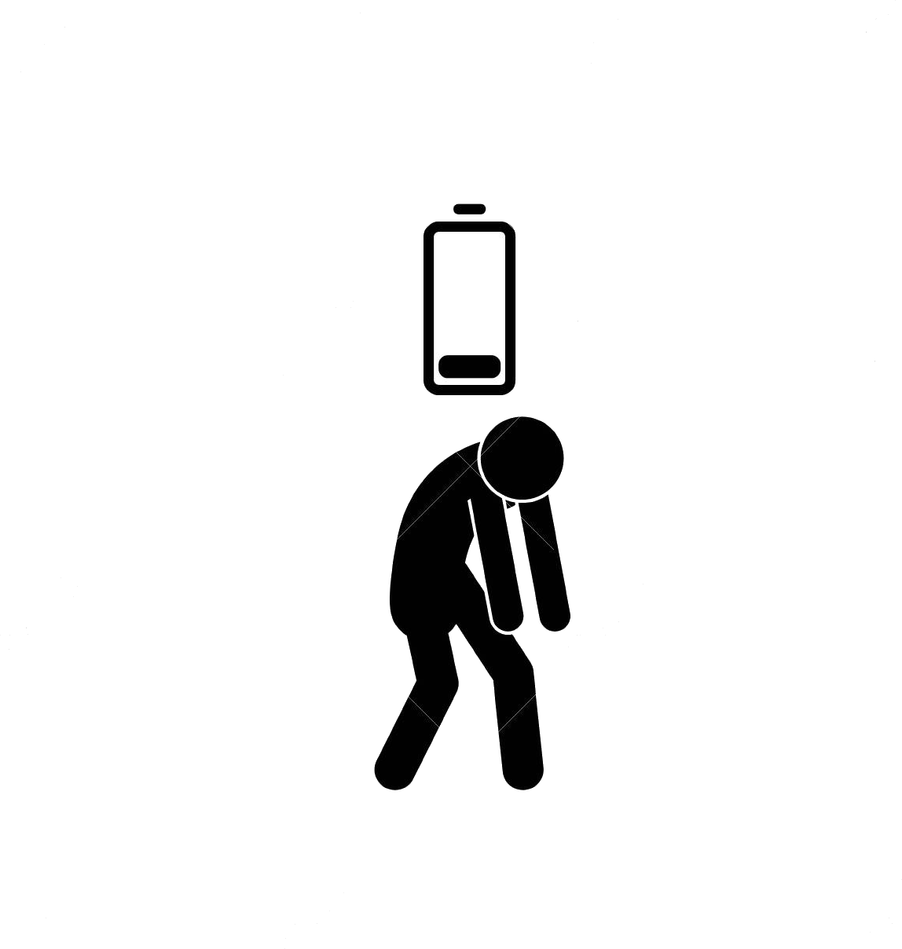





Symptoms of Covid -19
Fever
Lack of oxygen level in blood
Dry cough
Rise in heart rate
Tiredness

Slide 6

OBJECTIVES
Minimizes the spread of virus from that patient to others by
early monitoring the conditions of the person.
Portable and Light weight.
Triggers automatically in case of abnormal changes in the
human body.
Cost Efficient.

Slide 7
ORIGIN OF THE PROPOSAL
The main inspiration of this project came while we are searching and analyzing the pre-corona and post-corona situations of the patients. One day we came across a information in which people were being tested positive after they were sent home from quarantine and treatment centres and because of that people around him were also being affected thereby increasing the number of virus cases.
We would like to share the links in which information regarding this kind of virus spread is mentioned and cases were recorded.
References :
https://economictimes.indiatimes.com/news/international/world-news/coronavirus-reappears-in-discharged-patients-raising-questions-in-containment-fight/articleshow/74385565.cms
https://www.indiatoday.in/coronavirus-outbreak/story/is-a-covid-19-patient-really-coronavirus-free-after-being-discharged-from-hospital-1666409-2020-04-13

Slide 8
PROPOSED METHODOLOGY
The proposed solution is an IOT based which contains ESP8266 12E micro controller and temperature sensor for measuring temperature, max30100 for measuring pulse rate and oxygen level in blood, OLED for display of all the details.
The major symptoms of covid-19 are:
Fever (increase in temperature of body)
Respiration problems( oxygen level in blood, pulse rate)
Fever or increase in temperature of body can be identified using temperature sensor a limit of 103.1 degrees Fahrenheit can be set as a safety limit.
Major respiratory problems include changes in oxygen level of blood and also pulse rate. So safety limits for oxygen level is set as 92%-100% and person with lung based issues records 88%-92% level of
oxygen in blood.
A limit of 105 beats per minute can be set as limit for pulse rate.

Slide 9
When there is a change with these values a trigger will be sent from device to the control room where the doctors or people for monitor the changes in the person. The ESP826612E works on WI-FI or Bluetooth tethering. Whenever a patient is being discharged from hospital or quarantine centre the staff need to equip him using this. So after going home if there is any change in conditions of the person a trigger will be sent and then the control room people can evacuate him by tracking him thereby reducing the spread of virus
When our customer comes in close contact with our peer customer who is experiencing covid symptoms
We alert the unaffected customer by an emergency prompt message in our band. (Their GPS location is
received using our app installed in our customers phone)

Slide 10
SOCIETAL AND MARKET IMPACT
In this corona time daily thousands of people were being quarantined and hundreds were being discharged from hospital. But monitoring these many people at a time is bit difficult task. Here’s where solution makes the task easy. By bringing this into market the government itself can equip this arrangement to the discharged patients and can monitor them. Whenever there’s a change in conditions of body trigger will be sent and government can take necessary actions. The proposed solution can be used as daily wear and it can be carried with the user easily.
Innovative items production with multipurpose use
Low cost and simple technology
Fast tracking and quarantining is possible
Pollution free solution (device)
Gives protection to all age groups
Very useful at this stage of covid-19 situations where large number of patients were being discharged daily

Slide 11
INTELLECTUAL PROPERTY
Main thing which differs in the ACTIVE COVID TRACKER from other bands is that we have connected the device using IOT concepts with the control room where the condition of the patients is monitored. Temperature sensor , MAX30100, OLED,
GPS for their location to monitoring various conditions of the patients.

Slide 12
FUTURE PLANS FOR COMMERCIALIZATION
Our solution is economically feasible and of affordable cost as the sensors are the things which make up the things. for now, we have designed in the way we could do but as a part of our future plans, we could develop this in much economical way with proper support.
PCB’s can be designed which reduces the cost of a kit as low as possible. Generally printing around 10 PCB’S take 700 rupees by this way we can get each one at very less cost. And also watch type of design can be made using 3d-modelling and 3d-printing so that this can be enclosed in a good way and this design can be used as daily wear and can be carried easily everywhere.
Estimated Price : ₹ 1500 /- only

Slide 13
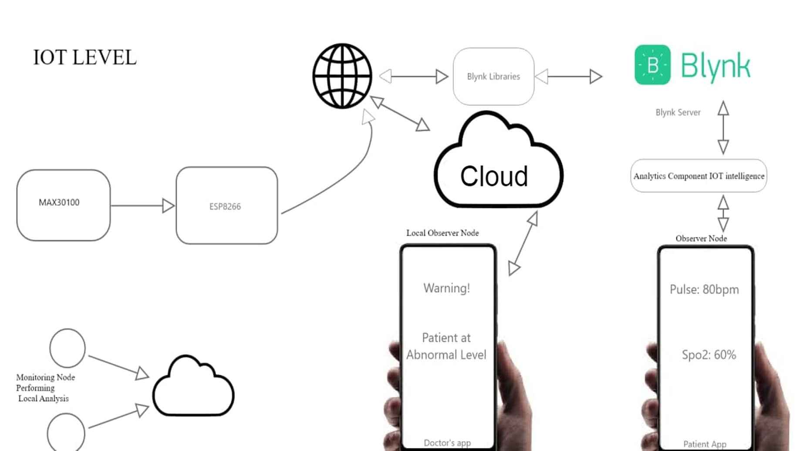

Slide 14
THANK YOU
IT’s NOT ABOUT IDEAS
IT’s ABOUT MAKING IDEAS HAPPEN …..

